Slide 1





Natural Language processing with recurrent neural networks, seq2seq models, attention and transformers
Korbinian Kottmann
Quantum Optics Theory group
Quantum Information Theory group
ICFO, Castelldefels
/Qottmann
@Qottmann

Slide 2

Recurrent neural networks

Slide 3
0. max likelihood method
1. recurrent neural networks
2. seq 2 seq models
3. Transformers
1990s
~2014
2017

Slide 4

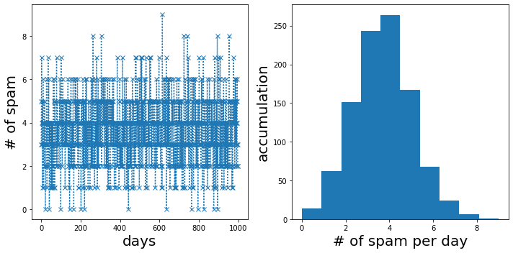
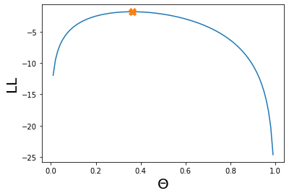
0. max likelihood method
Imagine you are receiving a fix number of n=10 emails a day. There is a chance of Θ that it is spam. You record the number of spam emails a day over the course of N=1000 days and this is what you obtain.
How do you determine Θ?

Slide 5
0. max likelihood method

Slide 6
0. max likelihood method
Need a model that can
- handle variable input/output lengths
- relate to all inputs (autoregressiveness)
I like to play football
I like to play [?]..
This restaurant is terrible
Me gusta jugar futbol
Football
Basketball
the violin
..
Positive review
Negative review

Slide 7
1. Recurrent neural networks
Output: conditional probability
for every word in the output vocabulary
RNN
RNN
RNN
Input: Sentence
Sentence is a sequence of words
Words are elements of a vocabulary
General ML jargon:
Sequences consisting of token
Time

Slide 8
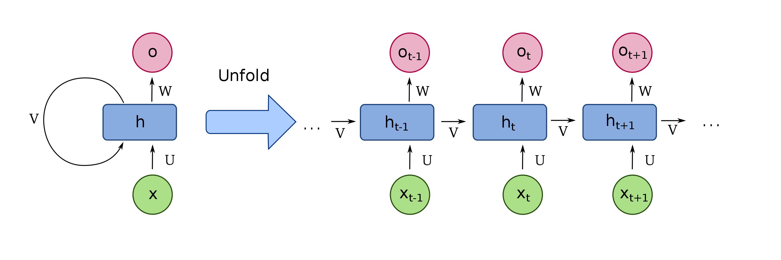
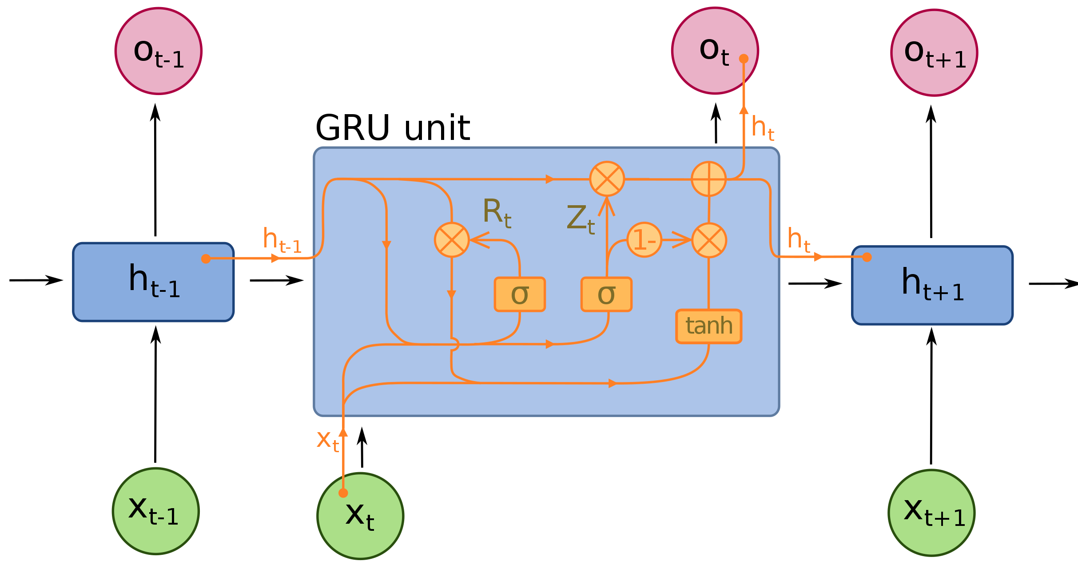
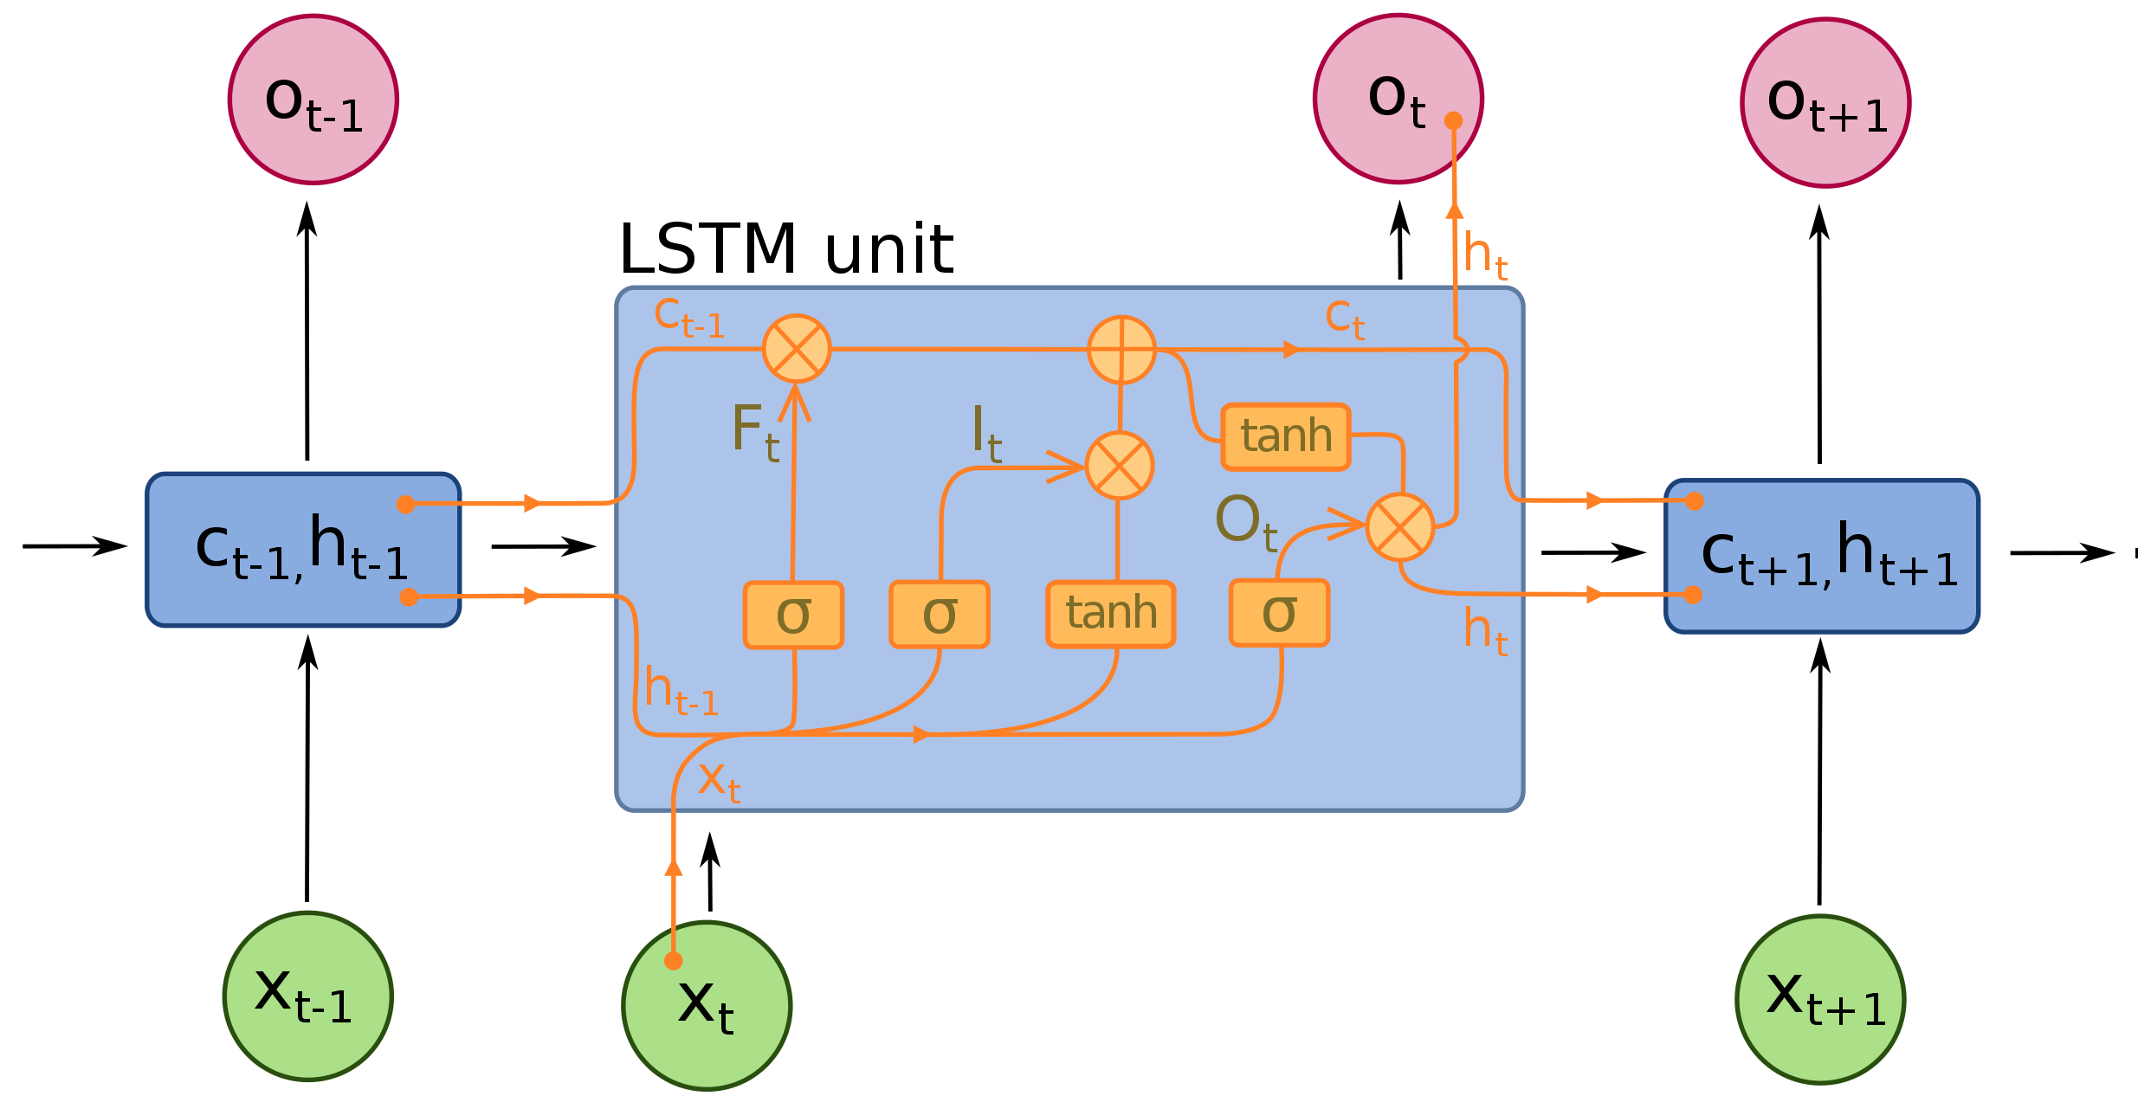
1. Recurrent neural networks
Simple RNN
Long Short-Term Memory
Sepp Hochreiter; Jürgen Schmidhuber (1997)
Gated Recurrent Unit
(Kyunghyun Cho et al. arXiv:1409.1259 2014)

Slide 9
1. Recurrent neural networks
Problems with RNNs:
1. In translation, only sentences with same input and output length
2. Hidden state is supposed to carry the sentiment of the whole sentence

Slide 10
2. Seq-2-seq models

Slide 11
2. Seq-2-seq models
Attention mechanism (one of many variants)

Slide 12
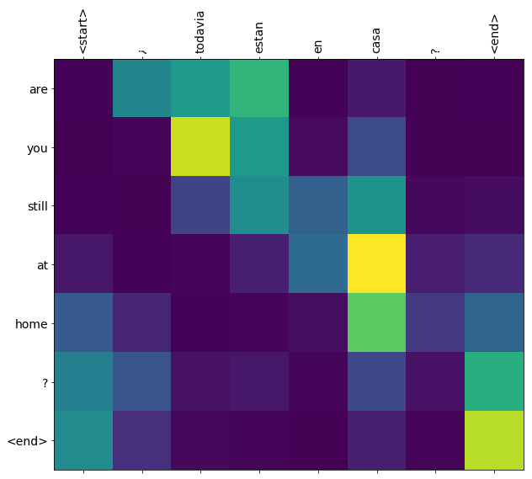
2. Seq-2-seq models

Slide 13
2. Seq-2-seq models
Problems with seq-2-seq models:
- Sequential processing not parallelizable and therefore slow training

Slide 14
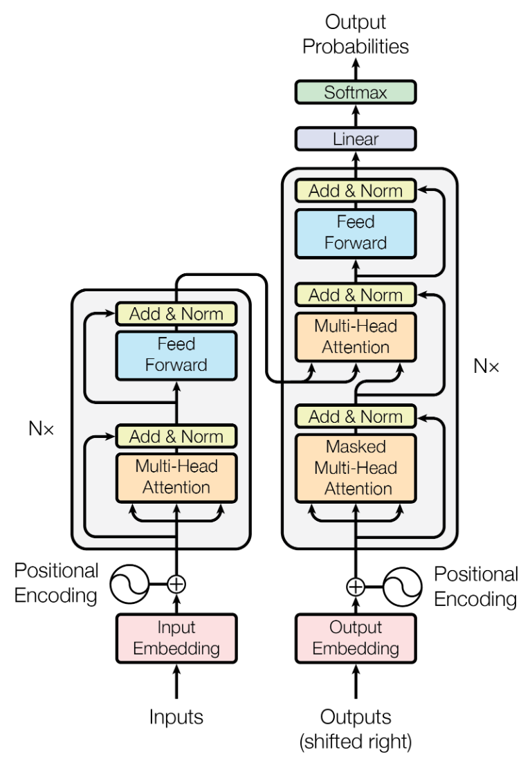
3. Transformers
Vaswani et al “Attention is all you need” arxiv:1706.03762 2017

Slide 15
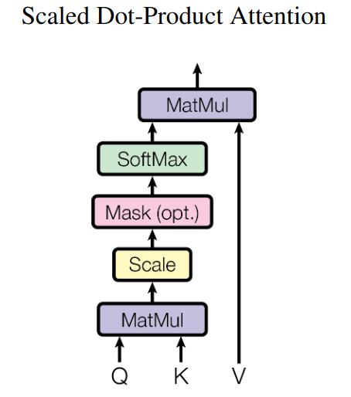
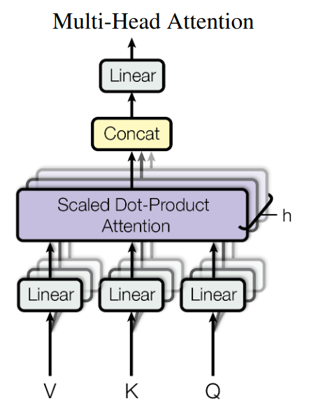
3. Transformers
Closer look, always Q = K,
So this is just all possible
Combinations of dot-products
Between inputs = attention scores
Convex combination of all value vectors

Slide 16
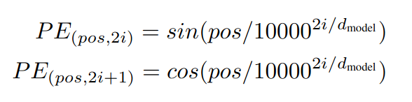
3. Transformers
Vaswani et al “Attention is all you need” arxiv:1706.03762 2017

Slide 17

3. Transformers
To reduce the dimension of the output probability vector (equal to the vocabulary size, less common words are replaced by a special token <unk> (unknown) and ignored.
Padding <pad> is used to accommodate the fixed input sequence length
The beginning / end of sentence indicates the start and end. In translation or word completion task, when <eos> is predicted, it is followed by <pad> until the end of the sequence.
Open problems:
Extra-long sequences: e.g. “Longformer” https://arxiv.org/pdf/2004.05150.pdf (ongoing research)
No reasoning due to a lack of abstraction level. These language models do not ‘understand’ language, but rather become extremely well at mimicing it (like a very sophisticated parrot).

Slide 18
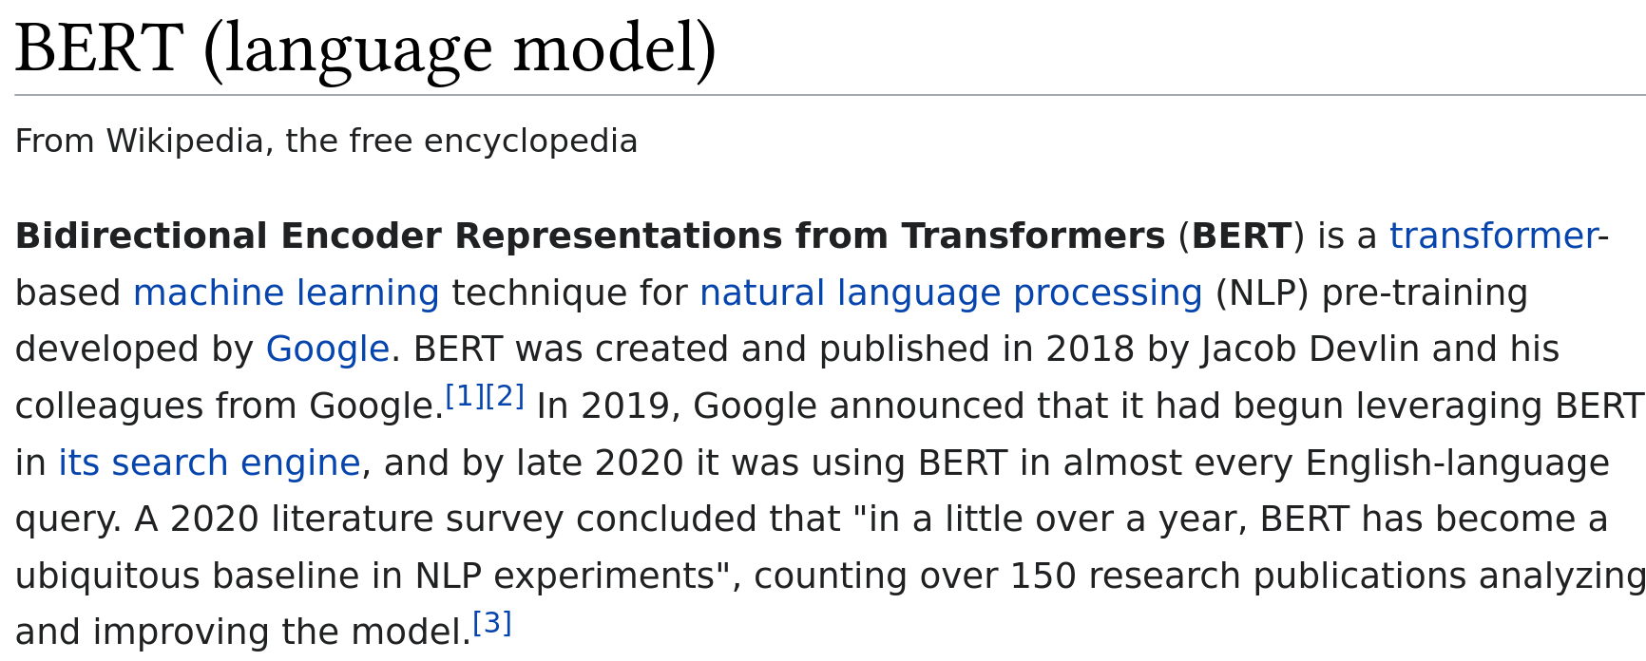
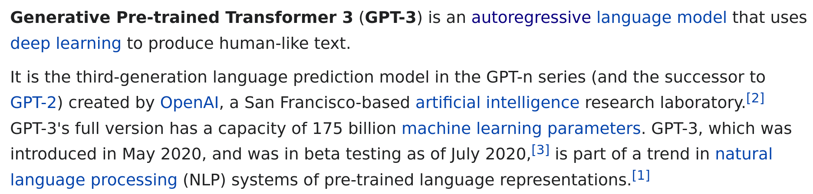
3. Transformers
Nonetheless, they are commercially used and very successful due to the large amounts of data
that can be efficiently processed with them

Slide 19
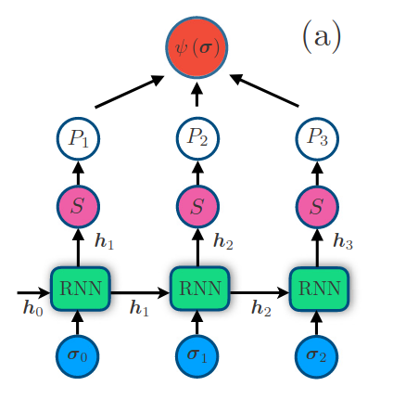
4. autoregressive models in physics
Mohamed Hibat-Allah, Martin Ganahl, Lauren E. Hayward, Roger G. Melko, and Juan Carrasquilla
“Recurrent neural network wave functions”
Phys. Rev. Research 2, 023358 – Published 17 June 2020
https://doi.org/10.1103/PhysRevResearch.2.023358

Slide 20
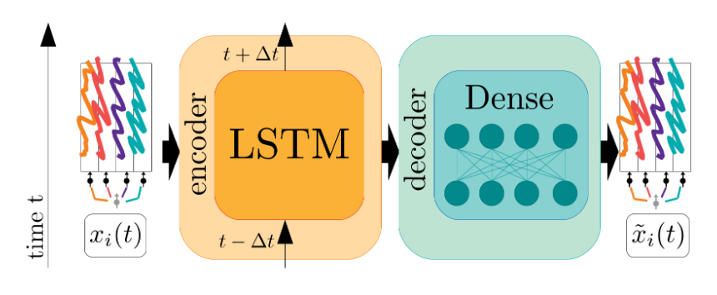
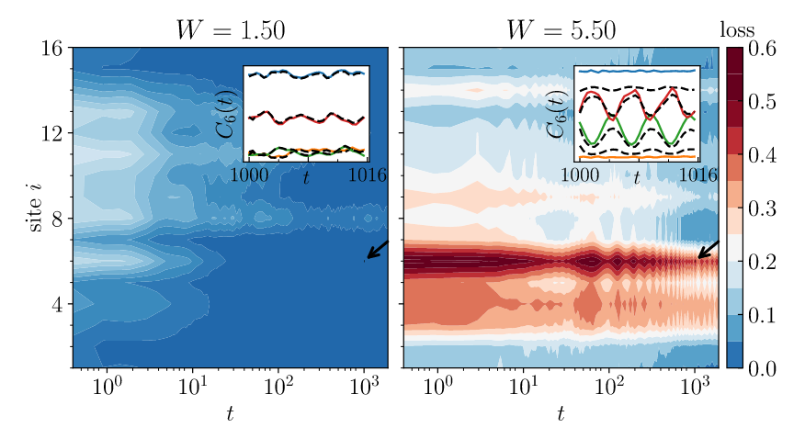
4. autoregressive models in physics
Tomasz Szołdra, Piotr Sierant, Korbinian Kottmann, Maciej Lewenstein, and Jakub Zakrzewski
“Detecting ergodic bubbles at the crossover to many-body localization using neural networks”
Phys. Rev. B 104, L140202 arxiv:2106.01811
https://doi.org/10.1103/PhysRevB.104.L140202

Slide 21
Natural Language processing with recurrent neural networks, seq2seq models, attention and transformers
Korbinian Kottmann
Quantum Optics Theory group
Quantum Information Theory group
ICFO, Castelldefels
/Qottmann
@Qottmann

